Slide 1
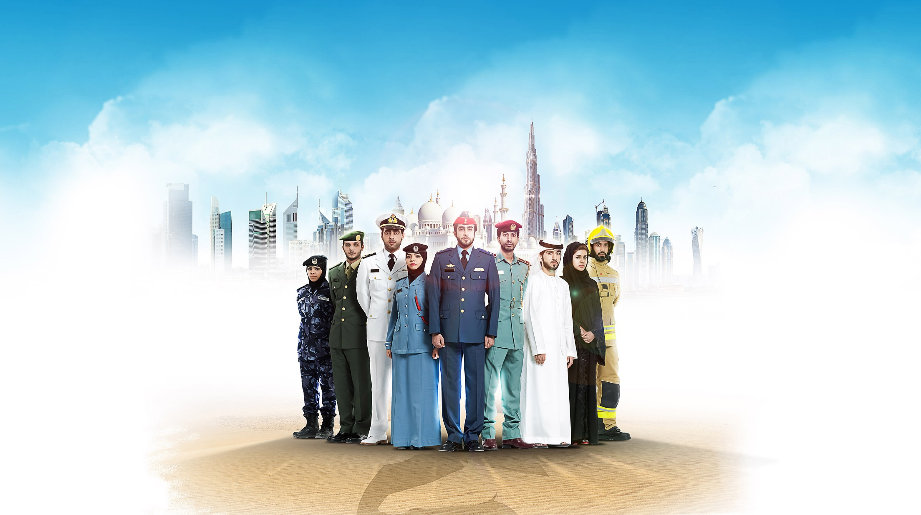



Towards a more resilient nation

Slide 2



4th Generation Warfare
Dr. Faisal Obaid Al Ayyan | Academic Vice President
26 July 2016
Towards a more resilient nation
Notes:
Baynunah Class Ship with 76mm gun
Apache
G6 155mm self propelled howitzer
F-16

Slide 3
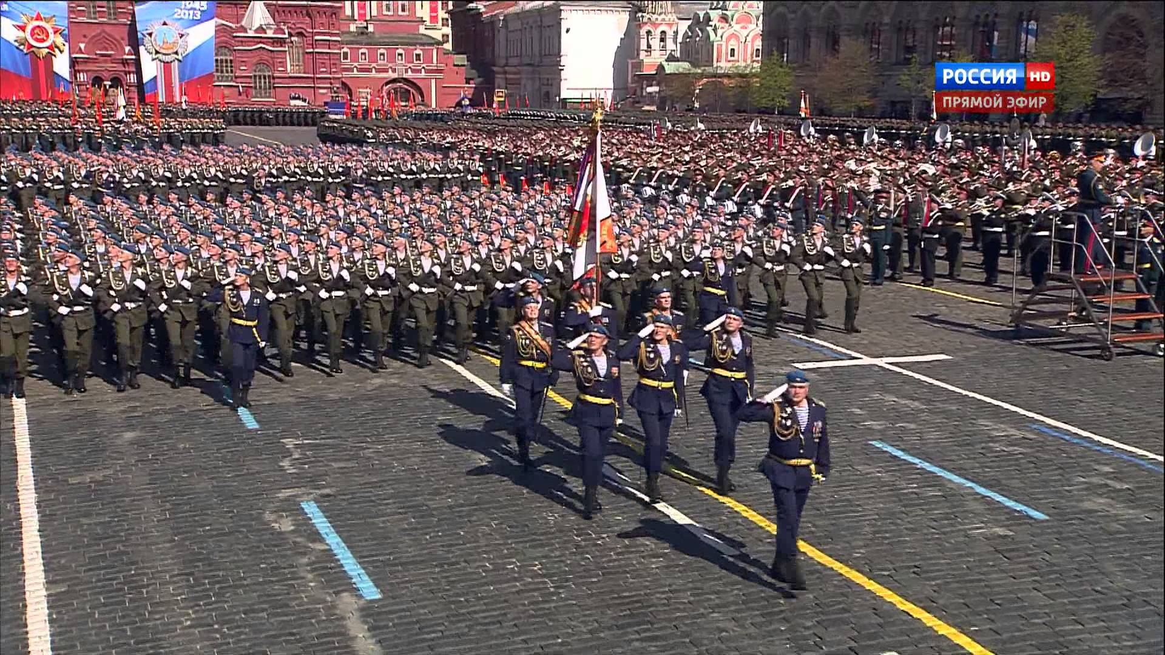
Key Questions
Has warfare changed since the end of the cold war?
What does it mean for militaries?

Slide 4
The Strategic Context
Two Keys
Since 1989 US is sole hegemonic power
Since the 90s globalization has accelerated, largely due to technology
Significant technical advantages force opponents to either close the technical gap or exploit weaknesses in and brought on by technology to defeat the US and its allies
Decades long trends in insurgency and terrorism accelerated in the late 90s and early 21st century
Notes:
The end of the Cold War left the US and its allies as the sole remaining hegemonic power. The American and its western allies vision of a peaceful and prosperous world linked by a range of new technologies was the dominant vision. The military, economic, political and cultural might was unchallenged. Any state or non state actor witnessing the first Iraq war was forced to address an increasing powerful opponent, and was going to have to decide how. Was it going to match American’s advantages or was it going to exploit weakness in and the US reliance on technology and firepower.
For non-state actors it was clear the latter was the only way forward.
An assumption that the concluded superpower conflict, and the state sponsored proxy war fought across the world, would bring about peace proved false . Diverse conflicts in the former Yugoslavia, Colombia, Somalia, Liberia, and Afghanistan all shared one underlying condition, the loss- to varying degrees of state legitimacy and its replacement with tribal, ethnic, religious or criminal organizations. Rather then relying on state sponsorship, these conflicts utilized diaspora networks to funnel money, material support, recruits to the conflict. Similarly, criminal groups utilized these networks to move illicitly move contraban and people for both their own ends and increasingly in cooperation with terrorist and insurgent groups.

Slide 5

Generations of Warfare
Notes:
The concept of Generations of warfare has generated considerable debate. However it has contributed to a new way of thinking about warfare and how the defense community should be organized and thinking about war. One note, we have adopted a more extensive view of the sweep of generational conflict then its original proponents, but the expanded historical perspective is faithful to the concepts original vision and intent.

Slide 6
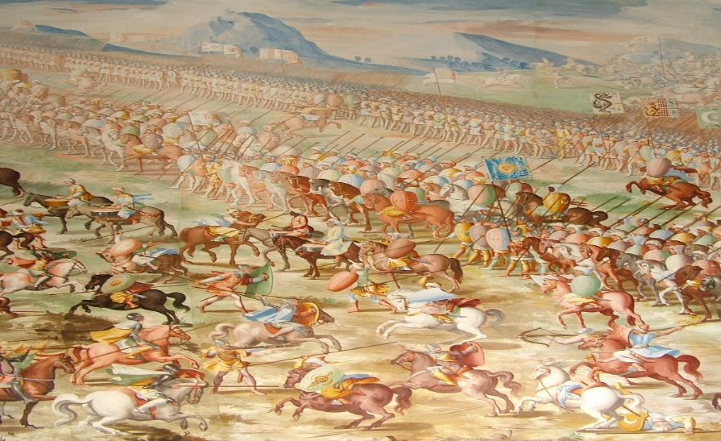
1ST Generation Warfare
1GW: 3,000 BC to 600 Ancient to Pre-classic. Aim is to destroy the opposing army using massed manpower tight ridged formations of uniformed troops. Strict hierarchal command and control.
Notes:
The key point here is that while the governing structure is not what the proponents 4gn typically view as the state, there was a structure and a means of legitimizing the use of violence so it is a valid use of the generations of warfare concept, and allows us to address one of the citizens of the theory that it is ahistorical. This type of combat relied heavily on close quarters combat of a high intensity.

Slide 7
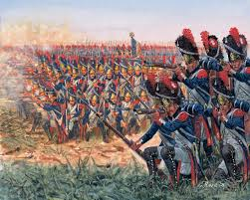
2nd Generation of Warfare
2GW: 1450-1860 Early Modern. Aim is to destroy the opposing army using massed firepower rather than mass manpower, tactics still basically linear
Notes:
4th Generation warfare typically begins with 1689 and the rise of the western state system with the Treaty of Westphalia and concludes with the American Civil War in 1860. The treaty ended the 30 years war in modern Germany and provided the basis for our current state system. The key for our discussion is that it granted the ruler, the sole legitimate monopoly of the use of force in their territory. Here is also the first time that what would be considered modern technology, rifeling of firearms, plays a key role. Combat took place over longer ranges and mix of dated tacticts and accurate long rang fire, produced heavy causalities. Proponents would say this stage ends in 1917-1918 late in the First world War when Germany introduced the Stormtrooper and other special units designed to overcome the war’s stalemate and defeat allied trenches. Thus what we have listed would as 2nd would be split between 1st and 2nd. The conception we have adopted, used by many proponents, remains true to the underlying assumptions and analytical scope of the original proponents.

Slide 8
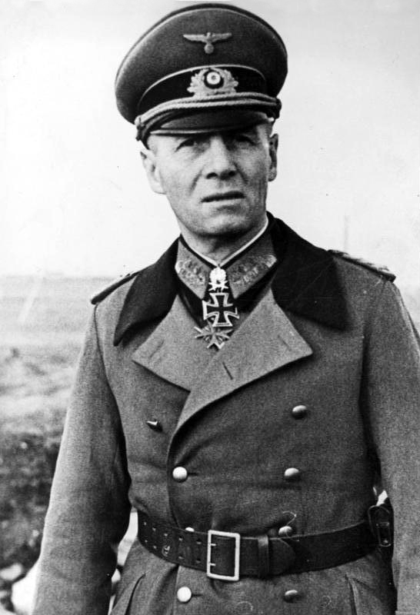
3rd Generation Warfare
3GW: Late 19 teens current. Goal is to out maneuver and collapse an opposing army rather than destroy it in a head on conflict. Same weapons; but: non-linear tactics. Emphasis on speed, surprise and combined arms (blitzkrieg, Infiltration) Command and control is devolved
Notes:
The carnage of modern warfare was plain for all to see during the Frist World War. In an effort to avoid this, as well as take advantage of new technology such as aircraft, armor and enhanced communications, many nations began to experiment with what the Germans would prefect with blizkreg. The speed and maneuverability of forces would reduce the extreme causalities of the First World War. The American and other modern militaries remain highly committed to this generation, demonstrating its full potential during the ‘Shock and Awe’ of the first Iraq War and the invasion phase of the second.

Slide 9
Key to early generations of warfare
Strategy is to defeat the enemies army to influence its society
Command and control have devolved but remained in the hands of the state
Operations are designed for short high intensity conflicts
Tactics have evolved with technological changes but are still confined to standard conventional military approaches
Notes:
While typical discussions of generational warfare focus on the military implications, many of the proponents of 4GW try to link the military with the technological and cultural implications. Thus the key elements listed here are embedded in a wider societal context. People are still linked to the state through formal political institution and through hieratical civil society organizations like labor unions, religious bodies or social clubs. Information is passed though a filter and tied to a position and in many cases a geographic location and societal function. Thus warfare is conducted by militaries targeting other militaries the look and function like each other.

Slide 10
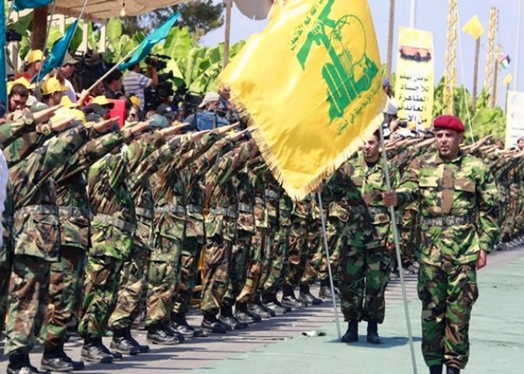
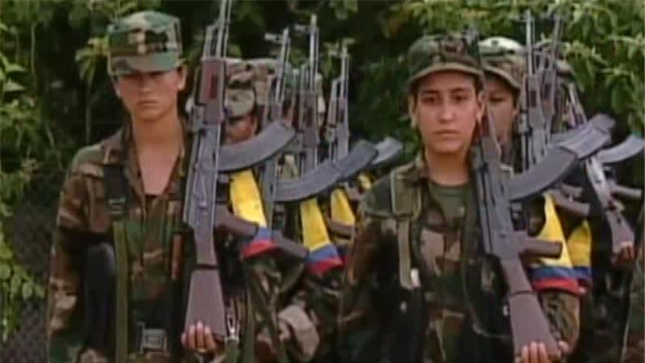
4th Generation Warfare
First emerges in 1989
Means to explain shift from state centric violence to non-state actor vs. state violence
Notes:
A man named Bill Lind introduced the term 4th generation warfare, and is often credited with the entire notion of generational warfare, to try and explain how and why violence has changed and was the US military prepared for it. He defines the concept a shift from a state monopoly of violence to non-state actors. It should be noted that others have expanded concept to cover all historical periods which may be more expansive then originally intended. The proponents however would say that while the term emerged in the late 1980s 4th Generation Warfare had emerged in the early 20th century but its full potential was just becoming evident.

Slide 11
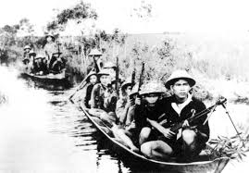
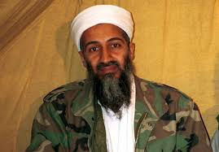

4th Generation Warfare
4GW: post World War Two to present. Strategy is to defeat the state through targeting its society and values, but avoids the military. Uses a combination of terrorism, guerrilla warfare as well as a range of political tools to weaken the will of the targeted population to support continued resistance to the groups demands. A loser diffuse hairachy that rests inexpensive commercially available technology
Notes:
One can use the Irish War of Independence in 1920-22 as an early example of 4th Generation Warfare where the Irish fought a guerrilla campaign in Ireland and terrorist attacks in the UK to undermine the legitimacy of British rule. The nationalists used violence, mobilization of its diaspora community to fund the fight and to use the politically powerful American Irish community to lobby its government to pressure the British to withdraw. Like most 4GW praticioners the IRA never thought it could win a direct confrontation with the British Army, however it looked to isolate the British from the population in Ireland as well as increase the actual and political costs of occupation to undermine its political legitimacy of the occupation and the political will to maintain it.
The Americans would experience similarly issues during the Vietnam War. Here however modern communicastrions allowed the Vietnamese communists to influence the American public in a way that they could never do even if they could have conducted operations in the US. The nightly images of a technologically superior nation using fire and manover- 3rd GEN, tactics to quell what some saw as a war of national unity, undermined the American willingness to prosecute the war. It is true that the Viet Cong were an arm of the North Vietnamese state and received significant support form the communist world, however it was the loss of American will and not a military defeat that caused the Americans to withdraw. That lesson, or an misunderstanding of that lesson drove Osama bin Laden to take the decisions, and brought the concept of 4 GN closer to its fulfilment.
The key to Osama bin Laden, Al-Qa’ida and more recently Dai’sh is the use of the global diaspora. Al Qa’ida used a network of supporters in a wide variety of countries to raise substantial amounts of money and recruit, initially to fight the Soviets in – such as mass hijackings- using aircraft as cruise missiles, and suicide attacks –a poor mans smart bombs- in sophisticated ways. Increasingly states are seeing their security threatened by hackers, such as anamoyous, threating not just their information but critical infrastructure from the safety of the internet. As 4th generation warfare evolves it threatens to turn the very tools of the modern world against the modern world.

Slide 12
Comparison
1st-3rd Generation Warfare
4th Generation
Strategy is to defeat the enemy's army to influence its government
Command and control have devolved but remained in the hands of the state
Operations are designed for short high intensity conflicts
Tactics have evolved with technological changes but are still confined to standard conventional military approaches
Strategy is to defeat the society to influence its government
Command and control have shifted from the state to individuals and is further dispersed
Tactics have shifted to include both military and non-military targets and means
Notes:
Focusing strictly on warfare, the first three generations focus on the defeating the advisories military in short high intensity conflicts using a mix of firepower and maneuver to impose its will on the opposing government. The 4th generation war shifts the focus; it avoids the military as much as possible to target the population in a war of attrition. Thereby undermining the will of the population to support the government. This has a tendancy to widen the potential targets available to the combatant, as well as opening a range of new lines of operation.

Slide 13
Generation of Warfare Groups
Notes:
The concept of Generations of warfare has generated considerable debate. However it has contributed to a new way of thinking about warfare and how the defense community should be organized and thinking about war. One note, we have adopted a more extensive view of the sweep of generational conflict then its original proponents, but the expanded historical perspective is faithful to the concepts original vision and intent.

Slide 14
4th Generation Wars and Groups
Wars
Groups and motivations
Al Qa’idal/Da’ish vs World
Hezbollah vs Israel and in Syria
FARC vs Colombia
D-Company vs India
Huthis vs Coalition in Yemen
Al Qa’ida/Da’ish- religio-politico
Hezbollah- political
FARC (Colombia) political-criminal
D-Company criminal political
Houthis religo politico
Notes:
Just about all of the post World War Two wars can be characterized as 4th GW but there are several worth highlighting to illustrate different aspects of 4GW.
Al-Qa’ida/Da’ish are religio political groups as they seek political power to impose their view of their faith on a population. This includes using a global funding and recruiting network to sustain their main theater of operations (Afghanistan and Pakistan for AQ and Iraq Syria for Da’ish) criminal active for both groups as well as acting as a state in the case of Da’ish. Additionally both groups seek to conduct operations in their opponents homeland by radicalizing individuals and at the very least inspiring them to conduct operations from the United States to Indonesia. Both groups have extensive contacts with criminal groups, not only are they fighting each other in Afghanistan for control of opium production in Nangarhar Afghanistan, but AQ’s affiliate in North Africa AQIM protects Colombian cocaine shipments across its terrtory bound for Europe.
The best example of a 4GW groups is Hezbollah in Lebanon. Founded with Iranian support in the early 1980s the group quickly emerged as one of the most efficient and deadliest groups in the world. It runs charities, businesses, a theme park, and a TV station as well as having an armed wing active in Lebanon, Syria and Europe with a support infrastructure in Asia, South America and parts of Africa. It and its members are involved in a range of criminal activities to support the organization. It is also a political party in Lebanon with 12 seats in 128 member Lebanese parliament and 2 cabinet positions. Their reach, spread and capitalizes place them at the for front of the 4GW discussion.
FARC is a Marxist group that has been fighting the Colombian government since 1965. Since the 1990s the group has been funding its activities through extortion, kidnaping and protecting Colombian drug cartels. At some point during the 1990s it moved from protection to direct involvement in production and transportation of the narcotic. The group just signed a peace deal with the government that allowed it to keep its criminal proceeds and allows those accused of involvement in trafficking to escape justice. The group has shifted from an ideological organization to a criminal one. Terrorist and insurgent groups have always worked with criminals but the movement between categories is new to this type of warfare.
Shifting the other direction is the Indian criminal organization D-Company lead by Dawood Ibrahim that has been liked to the 1994 Mumbai bombings and may have provided a portion of the funding for the 9/11 attacks with money it received through a ransom payment. This criminal group has global reach and connections with terrorist groups in South Asia, and has criminal links here in the UAE.
, including sending out a message that the government was massacring people in a remote village. The most important tool of the group was its laptop.
Finally and perhaps most relevantly are the Houtis in Yemen. This Zaidi Shi'a group which bares the name of the family that founds and leads the movement, is one of the leading opposition groups in the complex war underway in Yemen. At one time the group was seen as a a moderate group taping into the general grievances. Discontent with the government and radical Salafi groups entering their territory caused a armed reaction form the Hothis that eventually lead to them taking a large part of northern Yemen. There are allegations that Iran has been supplying arms to the group, but this has been denied by both Iran and the Hothis, and has been difficult to confirm either way. Given Iran’s shared religion and geo-strategic interests in the region it would be surprising if there was no support for the Hothis. The group does manifest some 4GW elements, they are organized along religious and tribal lines, and have become more radicalized due to a failure of a government that lost its legitimacy. As the collation is discovering trying to wiin a war and rebuild, if not build, an legitimate government is very difficult and time consuming.

Slide 15
Radicalization, Recruitment, Financing
To varying degrees All 4th Generation warfare groups share common elements
They are violent manifestation of al larger social movement that services as a in person or virtual radicalizing agent
They rely on shared ethnic or religious identity to galvanize wider support
They are highly proficient at using technology for propaganda, training, recruitment, financing and inspiring operations
Notes:
The key driver for 4th GW is that there are large portions of a society that have lost all faith in the society that they are part of, or have never placed any in it, and they sense the only way to change things is violent action. The lose of legitimacy appears most pronounced in societies where there are ethnic or religious minorities that are excluded form the benefits of a wider society, or more profoundly do not feel that the material benefits they do receive are actually addressing their deeper problems. The easy of travel and wide spread availability of technology makes it easier for people to see their problems as part of a larger concern, such as wider oppression or disrespect of their ethnic or religious group. The easy manipulation of identity allows the groups to attract adherents without having to educate them in deeper ideological issues. It also allows these individuals an easy way of demonstrating support with no more then a key stroke. Thoes who want to take an active part in the struggle can easily obtain travel papers and low cost travel in our increasing interconnected world. Once again turning the benefits of a globalized world- travel and communications, against itself.

Slide 16
Is 4th Generation Warfare New
Proponents
Opponents
Bill Lind, particularly “Strategic Defense Initiative,” and “FMFM 1-A”
Martin van Creveld: The Transformation of War
Col T.X. Hammes, USMC: The Sling and the Stone
Thomas P. M. Barnett: The Pentagon’s New Map & Blueprint for Action
Each of the above focus on a slightly different aspect but agree that the American military, and by extension its partners and allies, is not properly trained, equipped or oriented to dealing with the problem
Antulio J Echevarria II in Fourth Generation and Other Myths
Rob Thornton Asymmetric Warfare
The critics tend to argue that proponents are simply talking about insurgency in an ahistorical fashion. Further it is a floating concept blending different generations with technology
Notes:
The proponents of 4GW argue that the concept is important as it helps nations to understand the enemy, themselves, and why nations states seem to lose these wars more often not. In a strictly military sense, modern militaries are not properly oriented to the new generation of warfare. The strategies, doctrine and training are all ill equipped to address 4GW. More broadly modern society itself is fueling the change and is vulnerable to it. As power, authority and legitimacy ebbs away from the state it is not able to sustain the necessary political will to defeat an opponent that refuses to play to the strengths and political cycles of a modern state. For example the United States has been fighting in Afghanistan for 15 years and seems no closer to winning. It has been fighting an air war in Iraq, of various intensities since 1991 and there is an increasing gourd presence.
On the othe hand, the opponents say that the entire concept is just suspect. The 4GW is just another way of talking about guerrilla war and insurgency, that has been fought since humans organized into societies with different capabilities and resources. Rather then offering anything new, The opponent contend, the proponents simply want to talk about how technology has changed the world, which the opponents do not deny, and how the defense establishment needs to change with it.

Slide 17
Key Point
Opponents in each generation have the same ends- defeating the government of a given society
The ways of achieving that have shifted from targeting the military (1-3) to targeting the society (4)
The means have thus shifted from military centric tactics to an emphasis on political (domestic and international), non-violent and violent means of achieving the desired end
Notes:
The underlying message for 4GN is that placing an emphasis on fighting armed groups is misguided. The groups themselves recognize that the are not capable of wining a war, let along surviving the attention of a well equipped state. They thus are forced to rely on a strategy the utilizes armed conflict in a way that Mao did, as part of a campaign that utilizes political, non-violent AND violent means to achieve its ends. Thus groups like the MB and Hezbollah have survived as long as it has due to their ability to mix political action, non-violent protest, AND violence to achieve its end. If an opponent focuses on, and defeats Hezbollah's armed wing it will not have defeated the group since it is embedded in the wider society. Thus there is a need for a wide range of kinetic and non kinetic responses.

Slide 18
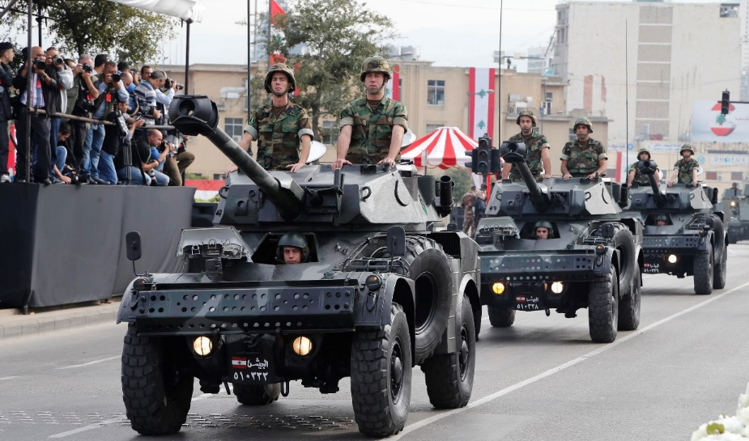
Why is the debate important
The acceptance or rejection of the concept has implications for conceiving of national defense.
It not only impacts how nations organize, train, and equip national armies:
Through shifting emphasis from pear competitors with a similar range of capabilities and technology (armor, aircraft, precision guided munitions)
To non state actors, both criminal and political operating globally, utilizing low tech (small arms and light weapons) to high tech (hackers and CBRN) to achieve their ends
Notes:
The implications of the debate are profound. If it is true that warfare has entered a generation of warfare with all the elements described above then highly lethal mobile military forces are inappropriate irrespective of the training and equipment. The war is about ethereal ideas and legitimacy of the state to impose its will on the population. The fact the military is being used at all reinforces the loss of legitimacy of the state, as it has had to resort to a large blunt force to restore its legitimacy, which violence is not capable of doing. What militaries can do is
restore governments power and order in a society,
Can destroy armed elements of the wider social movment the feeds the violent groups
It can prevent the groups from getting weapons of mass destruction that can caus massive damage and loss of lie
The can accomplish this though reorganization and emphaising light and special operations forces.
What militaries can not do
Restore lost legitimacy- the society for some reason has lost its confidence in the governments right to rule using force reinforces that
It can not win a war without popular support either at home or if the war overseas the local population. Similar to the first one no military can give the government the right to rule, only the ability coerice a population into submission.
If however this is wrong and 4GW is not the new model and the forces recognize the nation could be caught ill equipped to address a more conventional threat.

Slide 19
Importance of the debate
But it shifts national security from defense focused to a more whole of government approach including : Ministries of Interior, Foreign Affairs, Justice and even Education
And includes a range of non governmental organizations and civil society groups that can assist the state to detect, deter, and defeat a range of opponents.
This may require a state to fundamentally rethink how it is organized.
Notes:
In adopting the 4 GW approach, even if it is only a hedging strategy, there are something that can be done with out risking the national security if the approach is incorrect. By diversifying the response to the 4GW away from the military to a more whole of govenmnet approach one can leverage other capabilities to address the range of problems presented by the new warfare. For example if there is a fear from a government that it’s a portion of the population is becoming radicalized the ministry or department of education can be engaged to help a student see the error before he or she becomes violent. One can use resources to help establish civil society organizations to provide more points of contact with in the society to help detect, deter and assist a person who may become radicalized. The same approach can be taken overseas, either way doing this not only helps address the symptoms of the problem, but it could help to restore the states legitimacy which is the ultimate problem highlighted by 4th Generation Warfare.

Slide 20
Thank you
Towards a more resilient nation

